Slide 1
Spike-timing-dependent plasticity (STDP)
and its relation to differential Hebbian learning

Slide 2
Overview over different methods
You are here !

Slide 3

Differential Hebb Learning Rule
V’(t)
Simpler Notation
x = Input
u = Traced Input
x
X_{i}
ω
u_{i}
V
Early: “Bell”
Σ
X₀
u₀
Late: “Food”

Slide 4
Defining the Trace
In general there are many ways to do this, but usually one chooses a trace that looks biologically realistic and allows for some analytical calculations, too.
EPSP-like functions:
α-function:
k
Shows an oscillation.
Dampened
Sine wave:
k
Double exp.:
k
This one is most easy to handle analytically and, thus, often used.

Slide 5
Differential Hebbian Learning
Δω
Filtered Input
Derivative of the Output
T
Output
Produces asymmetric weight change curve
(if the filters h produce unimodal „humps“)

Slide 6
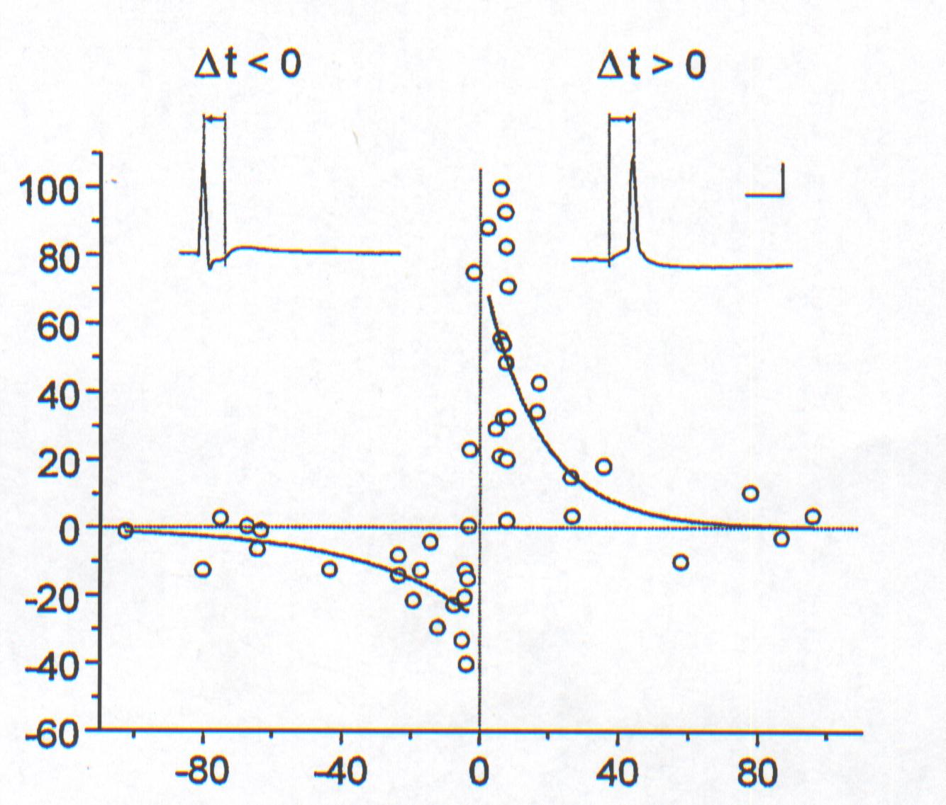
Spike-timing-dependent plasticity (STDP): Some vague shape similarity
Pre
Post
Synaptic change %
t_{Pre}
t_{Post}
Post
Pre
Pre precedes Post:
Long-term
Potentiation
t_{Pre}
t_{Post}
Pre follows Post:
Long-term
Depression
T=t_{Post} - t_{Pre}
ms
Weight-change curve (Bi&Poo, 2001)

Slide 7
Hebbian learning
When an axon of cell A excites cell B and repeatedly or persistently takes part in firing it, some growth processes or metabolic change takes place in one or both cells so that A‘s efficiency ... is increased.
Donald Hebb (1949)
A
B
A
t
B

Slide 8
Conventional LTP
Synaptic change %
Pre
Post
Post
Pre
t_{Pre}
t_{Post}
t_{Pre}
t_{Post}
Symmetrical Weight-change curve
The temporal order of input and output does not play any role

Slide 9
The biophysical equivalent of
Hebb’s postulate
Plastic
Synapse
Presynaptic Signal
(Glu)
NMDA/AMPA
Postsynaptic:
Source of
Depolarization
Pre-Post Correlation,
but why is this needed?

Slide 10
Plasticity is mainly mediated by so called
N-methyl-D-Aspartate (NMDA) channels.
These channels respond to Glutamate as their transmitter and
they are voltage depended:

Slide 11
Biophysical Model: Structure
x
NMDA
synapse
v
Source of depolarization:
1) Any other drive (AMPA or NMDA)
2) Back-propagating spike
3) Dendritic Spike
Hence NMDA-synapses (channels) do require a (hebbian) correlation between pre and post-synaptic activity!

Slide 12
Local Events at the Synapse
x₁
Current sources “under” the synapse:
Synaptic current
ΣLocal
Currents from all parts of the dendritic tree
Influence of a Back-propagating or dendritic spike
u₁
I_{synaptic}
ΣGlobal
v
I_{BP}
I_{Dendritic}

Slide 13
Membrane potential:
Weight
Synaptic input
Depolarization source
Pre-syn. Spike
On „Eligibility Traces“
g_{NMDA}
*
ω
Σ
BP- or D-Spike
V*h

Slide 14
Model structure
Dendritic compartment
Plastic synapse with NMDA channels
Source of Ca²⁺ influx and coincidence detector
Source of depolarization:
1. Back-propagating spike
2. Local dendritic spike
Plastic
Synapse
Source of
Depolarization
NMDA/AMPA
g
NMDA/AMPA
BP spike
Dendritic spike

Slide 15
NMDA synapse -Plastic synapse
NMDA/AMPA
Plasticity Rule
(Differential Hebb)
g
NMDA/AMPA
Source of depolarization
Instantenous weight change:
Presynaptic influence Glutamate effect on NMDA channels
Postsynaptic influence

Slide 16
NMDA synapse -Plastic synapse
NMDA/AMPA
Pre-synaptic influence
g
NMDA/AMPA
Source of depolarization
Normalized NMDA conductance:
NMDA channels are instrumental for LTP and LTD induction (Malenka and Nicoll, 1999; Dudek and Bear ,1992)

Slide 17
Depolarizing potentials in the dendritic tree
Dendritic
spikes
(Larkum et al., 2001
Golding et al, 2002
Häusser and Mel, 2003)
Back-propagating spikes
(Stuart et al., 1997)

Slide 18
NMDA synapse -Plastic synapse
NMDA/AMPA
Postsyn. Influence
g
NMDA/AMPA
Source of depolarization
Filtered Membrane potential =
source of depolarization
Low-pass filter
Filter h is adjusted to account for steep rise and long tail of the observed Calcium transients induced by back-propagating spikes and dendritic spikes (Markram et al., 1995; Wessel et al, 1999)
The time course of the [Ca²⁺] concentration is important in defining the
direction and degree of synaptic modifications. (Yang et al., 1999; Bi, 2002)

Slide 19
What triggers LTP/LTD: The role of Ca²⁺
Differential threshold hypothesis
(Artola and Singer, 1993; Lisman 1989)
LTD: low intrinsic [Ca²⁺] threshold
LTP: higher intrinsic [Ca²⁺] threshold
Problems:

Slide 20
STDP
post before pre:
Mg²⁺ is already removed
NMDAR opens (a slow process!)
little Ca²⁺ influx
pre before post:
NMDAR is already open
Mg²⁺ is then removed
much Ca²⁺ influx
pre long before post:
NMDAR starts to close
Mg²⁺ is then removed
little Ca²⁺ influx
But no late LTD window found ??

Slide 21
Ca-Gradient
temporal development of Ca²⁺ matters (Ca-gradient)!

Slide 22
STDP
post before pre:
Mg²⁺ is already removed
NMDAR opens (a slow process!)
SLOW Ca²⁺ influx
pre before post:
NMDAR is already open
Mg²⁺ is then removed
FAST Ca²⁺ influx
pre long before post:
NMDAR starts to close
Mg²⁺ is then removed
FAST (but little) Ca²⁺ influx
no late LTD window found

Slide 23
Some more physiological complications !
Modeling Ca²⁺ pathways
I
+ Back-propagating spike
NMDA
We are modeling Ca2+ rise and fall with just one diff. hebb rule. More detailed models look at LTP and LTD as two different processes.
Ca²⁺ concentration and gradient
Calmodulin
Ca²⁺/CaM Kinase II
Calcineurin
Phosporylation
Synapse gets stronger=LTP
AMPA receptors
Dephosporylation
Synapse gets weaker-LTD

Slide 24
NMDA synapse -Plastic synapse
NMDA/AMPA
Plasticity Rule
(Differential Hebb)
g
NMDA/AMPA
Source of depolarization
Instantenous weight change:
Back to this!
Presynaptic influence Glutamate effect on NMDA channels
Postsynaptic influence

Slide 25
NMDA synapse -Plastic synapse
NMDA/AMPA
Pre-synaptic influence
g
NMDA/AMPA
Source of depolarization
Normalized NMDA conductance:
NMDA channels are instrumental for LTP and LTD induction (Malenka and Nicoll, 1999; Dudek and Bear ,1992)

Slide 26
Depolarizing potentials in the dendritic tree
Dendritic
spikes
(Larkum et al., 2001
Golding et al, 2002
Häusser and Mel, 2003)
Back-propagating spikes
(Stuart et al., 1997)

Slide 27
NMDA synapse -Plastic synapse
NMDA/AMPA
Postsyn. Influence
g
NMDA/AMPA
Source of depolarization
Filtered Membrane potential =
source of depolarization
Low-pass filter
Filter h is adjusted to account for steep rise and long tail of the observed Calcium transients induced by back-propagating spikes and dendritic spikes (Markram et al., 1995; Wessel et al, 1999)
The time course of the [Ca²⁺] concentration is important in defining the
direction and degree of synaptic modifications. (Yang et al., 1999; Bi, 2002)

Slide 28
Some Signals F

Slide 29
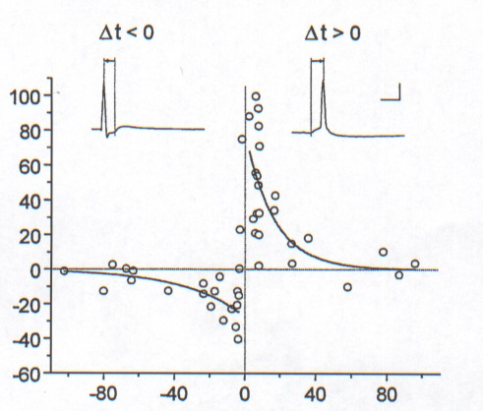
Weight Change Curves
Source of Depolarization: Back-Propagating Spikes
Back-propagating spike
Weight change curve
NMDAr activation
Back-propagating
spike
T
T=t_{Post} – t_{Pre}

Slide 30
Weight Change Curves
Source of Depolarization: Dendritic Spike
Dendritic spike
Weight change curve
NMDAr activation
Dendritic
spike
T
T=t_{Post} – t_{Pre}

Slide 31
Local Learning Rules
The same learning rule:
Hebbian learning for distal synapses
Correlations beyond
+-30 ms are mostly
random
Differential Hebbian learning for proximal synapses
Saudargiene et al Neural Comp. 2004

